Slide 1
CHAPTER 2: Introduction to Data Science

Slide 2
Contents
What is Data Science?
Data Science considerations
A strategy for Data Mining
CRISP-DM

Slide 3
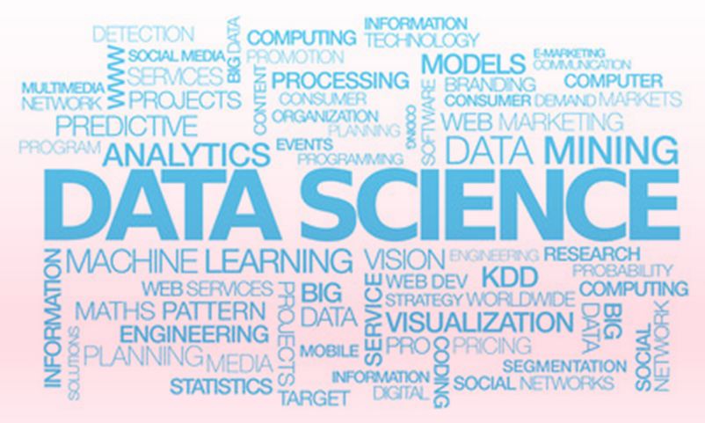
What is Data Science?
Myth about Data Science
Computer-driven process that looks for patterns in huge, complex databases and automatically gives results
Fact
User-driven process that uses computers to help wade through enormous amounts of data in order to discover useful patterns
Notes:
It’s user driven utilized by computers. There is no shortcut. There are softwares like Knowledge Studio that makes it easy, but, data science requires lots of thinking.
##
Broad availability of data and its high level of complexity have made it impossible to simply rely on traditional decision making techniques.
These conventional approaches predominantly use tools such as spreadsheets, database queries and other business intelligence tools.
Instead, increasing interest in methods for extracting meaningful information and knowledge from Big Data has made a shift from a gut-based decision making style to data-driven decision making style.
At the same time the convergence of various phenomena including powerful computers and computer networks, internet technologies, high volumes of data and efficient algorithms have given rise to data science principles and data mining techniques with the ultimate goal to improve and speed up the decision making process and consequently establish a competitive advantage.

Slide 4
Data Science Considerations – check before you model
Are data available and accessible?
Multiple locations
Data not yet electronic
Political and legal limitations to data availability
Do data cover relevant factors?
Are the data too noisy?
Missing data, subjective data
Is there enough data?
Representation and coverage of all possible outcomes
Is expertise on the data and relevant factors available?
Interpretation of results
Identify misleading/uninteresting artefacts
Knowledge Studio allows us to produce great models, but there is no substitute for critical thinking!
Notes:
Data is the most valuable business asset and a prerequisite to Data Science. Valuable sources of information
can be found throughout organizations and well beyond their borders i.e. internal and external data sources, both structured and unstructured.
subjective data -> How did you like your food in a restaurant survey is very subjective.
enought data -> Do you have all groups for a certain variable in your data? If you don't, when you build a model you won’t cover them. Then when it’s time to implement your model you won’t know what to do with people who weren’t represented.
Expert on data -> e.g there is a payment field in data , which has actually been created by an auto-dialer. There is another flag that tells if the payment actually made or not. If we don't know about that flag we might just use the payment field.
These are things that can really trick people out. So if you don’t have expertise on a specific data you need to ask who has the expertise. Expertise also helps us explain the results.

Slide 5
A Strategy for Data Mining
To guide your project, answer the following questions:
What substantive problem do you want to solve?
What data are available, and what parts are relevant?
What kind of pre-processing & cleaning is needed before starting?
What data mining technique(s) will you use?
How will you evaluate the results of the data mining analysis?
How will you get the most from the information you obtain from DM?
Notes:
-What substantive problem do you want to solve? So we don’t need a vague problem like I want to make more money! We want a problem like” I want people who owe me money pay frequently.” or I want to accept more account without changing bad account rates.
-What data I have. Do I understand data? Then go and search. Once I have access to data, which part is relevant. If someone gives me 8 files, how many of them are relevant. Do I need to link them? What is the linking field? Another example of irrelevant data is if you’ve got some information, the field you have is customer ID. This is a thing you need to know early on. I should not be using someone’s ID to predict whether or not defaults on credit. That’s not going to be a useful metric. If it is, then there is even a bigger problem. Because there should not be a relationship between a randomized number and whether or not somebody’s going to default.
-Now that you know that you need to link two tables, how do I do that? Are there missing value? What are data types? Sometimes there are strings and need to be converted to integers or dates. Some values have bunch of leading zeros and some doesn’t. So you need to know what kinds of preprocessing and cleanings you need to do early on. In the best case scenario if you have not thought about it in the early stage, it will take you longer. Because you need to cycle back and redo the work. In the worst case you get wrong results. So instead of getting errors, you’ve go wrong values. Sometimes it’s very hard to diagnose when you go that far. So you need to think about it early on. There’re other types of cleaning as well and not just linking data. For example, you see high percentage of null in ‘Capital gain’ field. Does it mean that those nulls means zero capital gain or those people are not investors?
-The list of techniques is almost endless these days. You should know in advance what you have access to, and sometime this is going to be determined based on your familiarity. If you are not familiar with neural network maybe it’s not the right time experimenting depending on your project turnaround time. Sometimes it’s based on regulations. If you need to explain your model, black boxed models are not the right choices versus using decision trees, which easily explains the factors of the model .
Sometimes you have enough time to try different models.
You want to build a neural net, a logistic regression, a tree and an ensemble model. You want to see which model gives you the best result. (decision tree deals with missing values perfectly as it creates a separate bin for them while linear regression cannot process missing values.) There is a bit of back an forth between DM techniques and pre-processing and cleaning data.
-You need to decide in advance what metric are you going to use to evaluate your analysis. So if the metric tells you your analysis is not good you go back and adjust your analysis.
-This is something you don’t know up front. But you need to decide how you are going to use the result of your model or data mining analysis in order to get value out of it. What are you gonna do to get the most amount of information. You need to think about it up front.
-

Slide 6
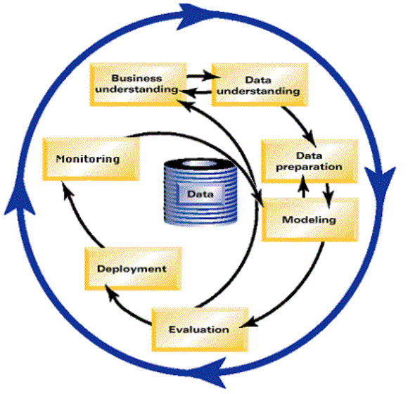

CRISP-DM
Determine business objectives and data mining goals
Collect, describe, explore and verify quality of data
A Cross-Industry Standard Process for Data Mining
A tool - and application - neutral model
Encourages best practices
Offers structure
Encourages better, faster results from data mining
Champion/
Challenger
Select, clean, construct, integrate and format data
Integrate into
business processes
Select, generate, build and evaluate models
Evaluate how results
achieve business objectives
Notes:
Once you have answer those questions CRISP -a structured approach- guide you through the data-mining cycle, keeping track of information to best generate the results.
You can use it across many industries -across many tools - and across many applications
Even though CRISP- DM is very structured enforcing you to go down specific path, in the long run, that actually make you, have faster results. Because you know the structure in advance – you don’t have to redevelop it every time- and that structure can avoid you from pitfalls that are actually time consuming.
…..
How to read? Start from the top. Business understanding and Data understanding. There is a double arrow back and forth. You have a business and that business generates data. The more you understand the business the more it helps you understand the data, and that data is going to help you understand the business better. So there is definitely a cycle there. Increase your business knowledge increase your data knowledge and vise versa. And that’s where the whole goal starts. To understand business better and we are going to using data to do that and that’s the whole point of datamining in general.
And once you have the data understanding which involves asking questions we talked about before, the next thing you can do is to go to data preparation. Maybe from the business understanding you know that certain variables should be logged transformed or exponentiated or squared or something. So you prepare your data in a way that make sense. You deal with missing values in a way that make sense. You do all the preparation to your data because you understand the data. There is a one way arrow there. The preparation itself does not usually help you understand the data better. You first understand the data and then go to data preparation. Profiling is different than data prep and it is part of data understanding.
Once your done with that you go on and prepare data to get it ready for modeling. However, once you prepare your data for modeling there is a cycle that goes on there. Because what’s often the case, when you prepare data for modeling and as you get prepared for modeling and try building the model, you realized that there is something in your data that you don’t have. And then you go back to data prep and then modeling again. The modeling itself, you often build a model and you look at the intermediate results, and then for improving you go back to data prep, modify, and return to modeling again. So there is a cycle between dataprep and modeling.
Once you are done with modeling you go to model evaluation. Notice that there is a one-way arrow here. You should never go back from evaluation to modeling. You build your model. You do the internal validation. You build the best model. Then you evaluate it separately. If the model is not good you don’t go back to make some adjustment. You have to go somewhere else to get some more business understanding and rebuild the model. You don’t want to say that ok let’s just make that tiny adjustment to make evaluation metric look better.
Once you’ve done the evaluation, sometimes you go to deployment – but you see that long arrow to business understanding, because there are cases where you build a model and some of these cases are just those I was describing which is the evaluation does not go very well; And this teaches you something too. You are not going to use that model but you have learnt something new about the business and you hopefully gain some business understanding.
On the other hand there are these cases that model and evaluation goes very well, you still learn something and you want to incorporate that right away or kick you off to a different model.
On the other hand there are many cases that you have the model and evaluation and you want to deploy that, like when you build a scorecard to see who you should lend money to. You want to put that in practice and make money.
When you do that you also want to monitor that model.
So after deployment there is Monitoring which is a necessary step. You need to keep watching it no matter what. If things change over time model degrades, population changes, or something else goes wrong. You need to keep your eyes on that. Or things gets great. Your model starts working better than ever.
With that monitoring you generate more data and then you can feed it back to your original data.
So you use that new data that you generated during monitoring and then you can build new model or retrain the model you have. Or you can build other models to predict other things.
So there are lots of things you can do with modeling once you have done monitoring. So that’s where this whole thing ends.
There is the thick blue arrow around outside which indicates that the whole process is going on and on and stuff recycles. That means that once you are done with a model, you have new/more questions, and that can lead you to how to solve other datamining problems. So this is a tool to solve more and more problems.
The course follows this set of best practice steps throughout

